Slide 1


Slide 2
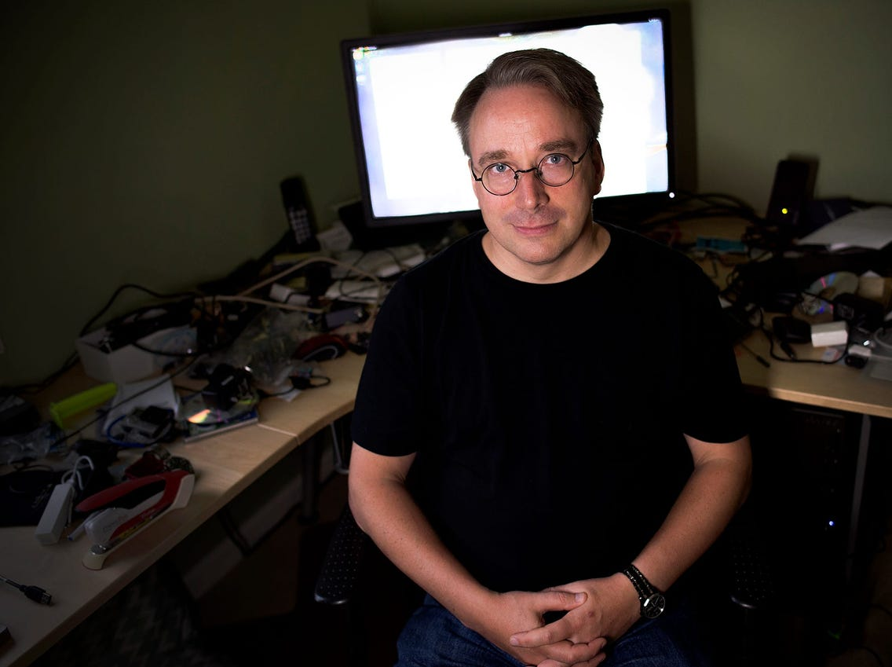
Linus Torvalds
Linus Torvalds, (born December 28, 1969, Helsinki, Finland), Finnish computer scientist who was the principal force behind the development of the Linux operating system.

Slide 3
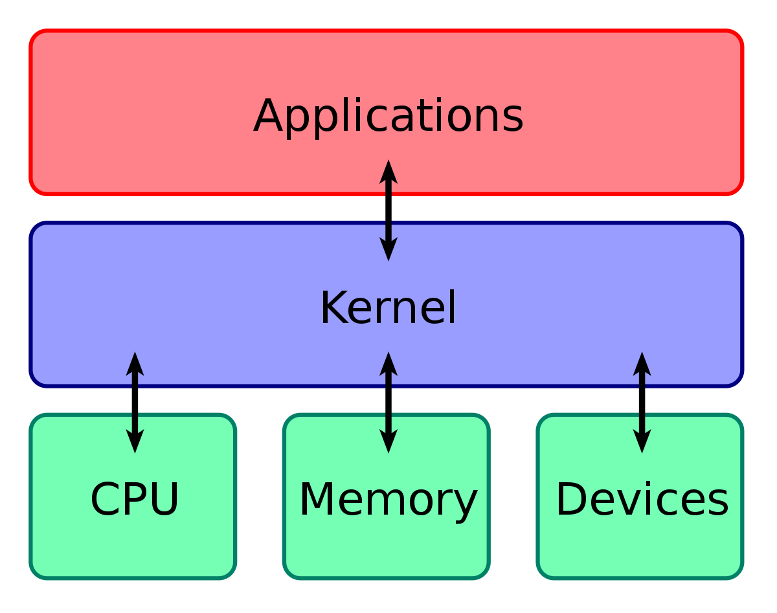
What is Linux?
Linux is nothing but a Kernel.

Slide 4
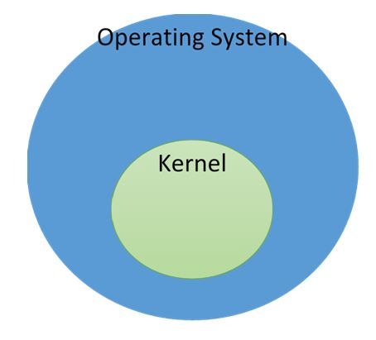

Slide 5


Slide 6
Advantages of Linux
Open Source
Security
Revive older computer systems
Customization
Various Distributions

Slide 7
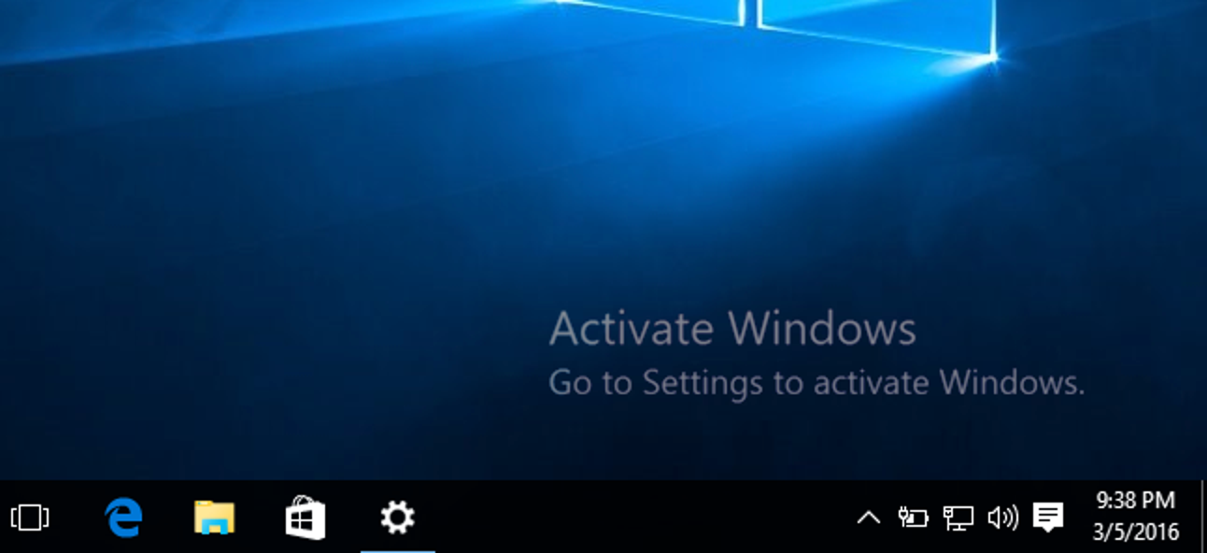

Slide 8

Disadvantages of Linux
Hard Learning Curve
Poor support for games
Difficult to Troubleshoot
Lack of Proprietary Software

